Slide 1
8
VECTORS AND THE
GEOMETRY OF SPACE
Copyright © Cengage Learning. All rights reserved.

Slide 2
8.4
The Cross Product
Copyright © Cengage Learning. All rights reserved.

Slide 3
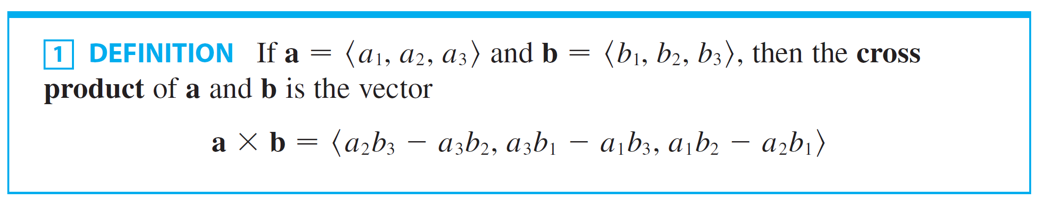
The Cross Product
The cross product a × b of two vectors a and b, unlike the dot product, is a vector.
For this reason it is also called the vector product.
Note that a × b is defined only when a and b are
three-dimensional vectors.

Slide 4
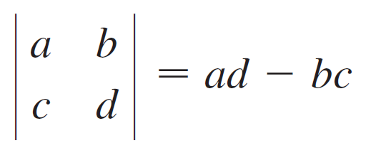
The Cross Product
In order to make Definition 1 easier to remember, we use the notation of determinants.
A determinant of order 2 is defined by

Slide 5
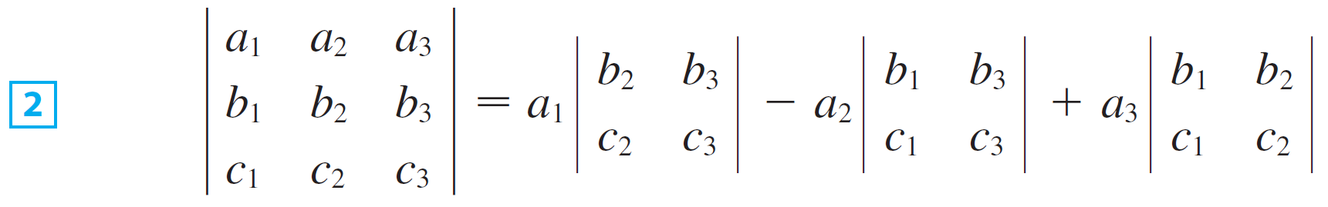
The Cross Product
A determinant of order 3 can be defined in terms of second-order determinants as follows:
Observe that each term on the right side of Equation 2 involves a number a_{i} in the first row of the determinant, and a_{i} is multiplied by the second-order determinant obtained from the left side by deleting the row and column in which a_{i} appears. Notice also the minus sign in the second term.

Slide 6
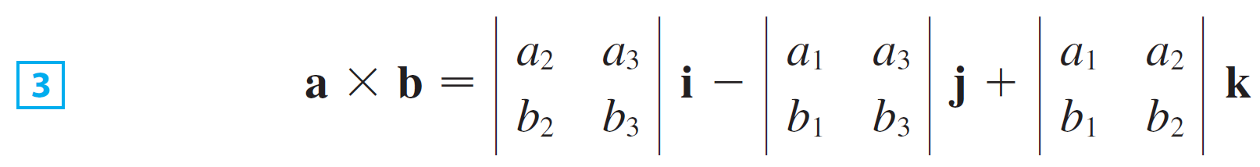
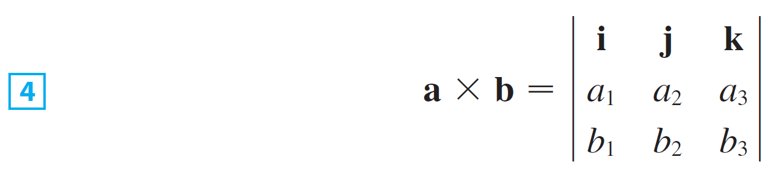
The Cross Product
If we now rewrite Definition 1 using second-order determinants and the standard basis vectors i, j, and k, we see that the cross product of a = a₁i + a₂j + a₃k and
b = b₁i + b₂j + b₃k is
In view of the similarity between Equations 2 and 3, we often write

Slide 7
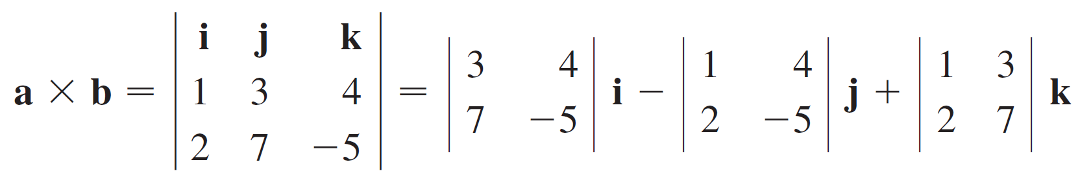
Example 1
If a = ⟨1, 3, 4⟩ and b = ⟨2, 7, –5⟩, then

Slide 8
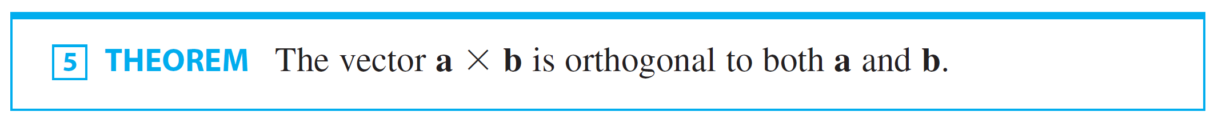
The Cross Product
One of the most important properties of the cross product is given by the following theorem.

Slide 9
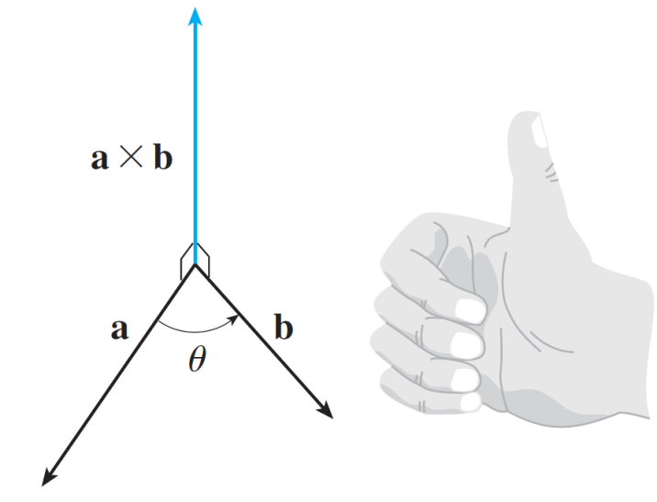
The Cross Product
If a and b are represented by directed line segments with the same initial point (as in Figure 1), then Theorem 5 says that the cross product a × b points in a direction perpendicular to the plane through a and b.
The right-hand rule gives the direction of a × b.
Figure 1

Slide 10
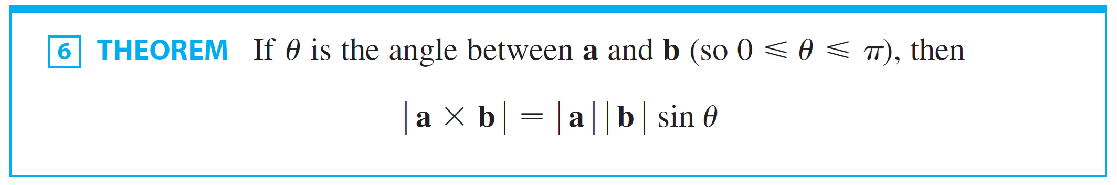
The Cross Product
It turns out that the direction of a × b is given by the
right-hand rule: If the fingers of your right hand curl in the direction of a rotation (through an angle less than 180°) from a to b, then your thumb points in the direction of a × b.
Now that we know the direction of the vector a × b, the remaining thing we need to complete its geometric description is its length | a × b |.
This is given by the following theorem.

Slide 11
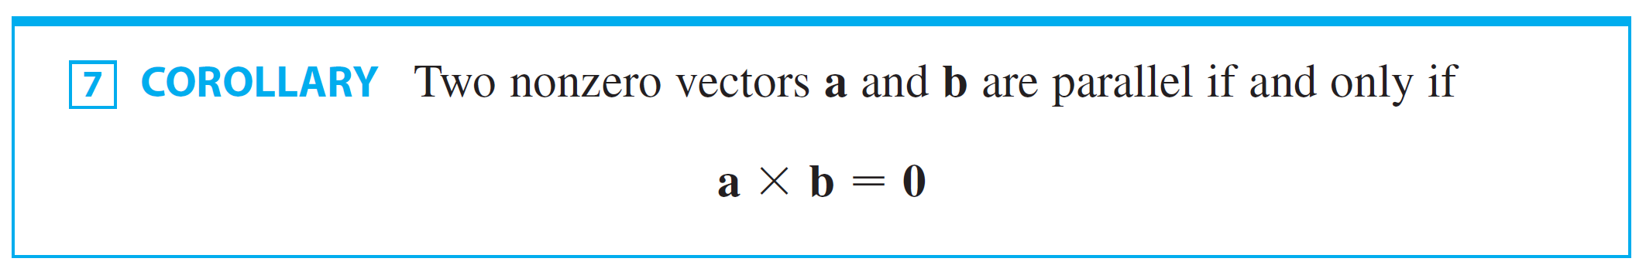
The Cross Product
Since a vector is completely determined by its magnitude and direction, we can now say that a × b is the vector that is perpendicular to both a and b, whose orientation is determined by the right-hand rule, and whose length is
| a | | b | sin θ.
In fact, that is exactly how physicists define a × b.

Slide 12
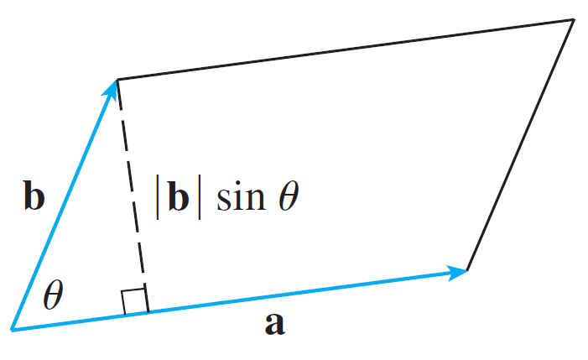
The Cross Product
The geometric interpretation of Theorem 6 can be seen by looking at Figure 2.
Figure 2

Slide 13
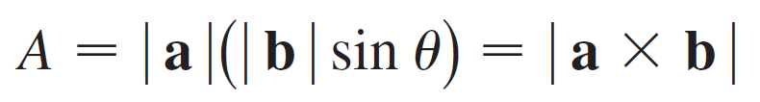
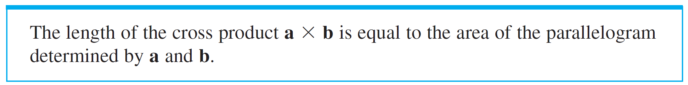
The Cross Product
If a and b are represented by directed line segments with the same initial point, then they determine a parallelogram with base | a |, altitude | b | sin θ, and area
Thus we have the following way of interpreting the magnitude of a cross product.

Slide 14




Example 3
Find a vector perpendicular to the plane that passes through the points P(1, 4, 6), Q(–2, 5, –1), and R(1, –1, 1).
Solution:
The vector is perpendicular to both and and is therefore perpendicular to the plane through P, Q, and R. We know that

Slide 15

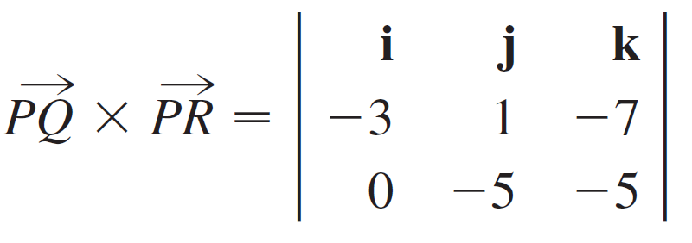

Example 3 – Solution
cont’d
We compute the cross product of these vectors:

Slide 16
Example 3 – Solution
cont’d
So the vector ⟨–40, –15, 15⟩ is perpendicular to the given plane.
Any nonzero scalar multiple of this vector, such as ⟨–8, –3, 3⟩, is also perpendicular to the plane.

Slide 17







The Cross Product
If we apply Theorems 5 and 6 to the standard basis vectors i, j, and k using θ = π / 2, we obtain
Observe that

Slide 18


The Cross Product
Thus the cross product is not commutative. Also
whereas
So the associative law for multiplication does not usually hold; that is, in general,

Slide 19
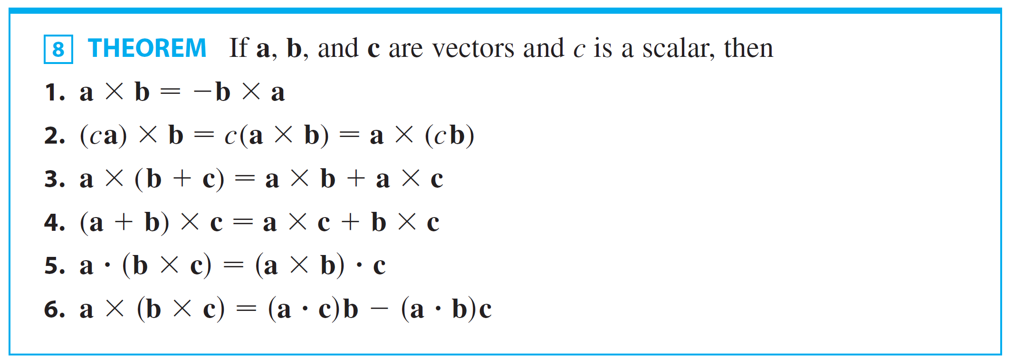
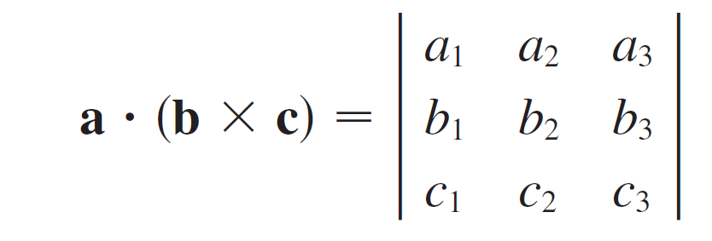

The Cross Product
The following theorem summarizes the properties of vector products.

